Slide 1

Ethics, Bias, and Fairness Part II:
The Wrath of Khan
Rayid Ghani and Kit Rodolfa

Slide 2
Recap: Most of these questions are not new
Ethical issues have always existed in every decision-making process but we are dealing with them now at a different scale and with a more data-driven view

Slide 3
Recap: Some questions we should be asking
Are you using data for purposes it’s intended for?
How are you protecting the data?
Do the people who “own” the data know you’re using it?
Do you have their permission? How was it obtained?
What actions are you taking on individuals based on this data?
Do the people you’re targeting know why and if they’re being targeted?
What recourse do they have?
Would it make the front page of NYT if they found out what you’re doing?

Slide 4
Data and AI Ethics Issues
Privacy
Data Ownership
Bias, Equity, & Fairness
Transparency
Trustworthiness and Accountability

Slide 5
Data and AI Ethics Issues
Privacy
Data Ownership
Bias, Equity, & Fairness
Transparency
Trustworthiness and Accountability

Slide 6
Trustworthiness and Accountability
Do policymakers understand what the analysis is doing?
Do action-takers understand and trust why they’re getting the recommendations they’re getting?
Do the people being acted on understand why?
What recourse do people being acted on have to appeal these decisions or identify and correct errors in the data or system?

Slide 7
Trustworthiness and Accountability
Who is accountable for the actions?
Who is deciding on the values encoded in the system?
Who is deciding when to (and not to) undertake a project?
How is the tradeoff between false positive and false negatives being set?

Slide 8
The Role for Interpretability
Debugging the Model
Creating and increasing trust and adoption
Improving the decisions being made
Selecting appropriate interventions
Legal Recourse

Slide 9


What is a good explanation and how do we evaluate one?
Ideally: We want human understandability and fidelity to the actual model
Task Specific: We want an explanation to improve the performance of the Human-ML system
73%
ML Model
Human Decision-maker
?%
ML Model
Explanation Module
Human Decision-maker

Slide 10
Examples
Predictive Policing: Why could it be bad?

Slide 11
Examples
Predictive Policing: Why could it be bad?
Data
Interventions
Counterfactuals
Are there good use cases for crime prediction?

Slide 12
Examples
Predictive Policing: Why could it be bad?
Data
Interventions
Counterfactuals
Are there good use cases for crime prediction?
Preventative Assistance Programs in Criminal Justice?

Slide 13
Data and AI Ethics Issues
Privacy
Data Ownership
Bias, Equity, & Fairness
Transparency
Trustworthiness and Accountability

Slide 14
How do we build AI systems that are fair and lead to equity?
What do we mean by equity?
How do we balance equity with other goals? Efficiency? Effectiveness?
Who do we want to be fair to? At what expense?
How do we define fairness?
Connecting equity goals in policy domains to “achievable” fairness metrics
Fairness Tree to help policymakers go from equity outcomes to AI models
Measuring Fairness
Understanding the root causes of bias
Improving the AI systems we develop
Mitigating the impact of unfair models to achieve fair outcomes
Monitoring and Evaluating

Slide 15
Common misconceptions in the real world
If I don’t use race in my analysis/models, then my analysis/models can’t be racist
If I use race in my models, then models are always racist
If my actions aren’t happening on individuals, then I don’t need to worry about bias

Slide 16
Equity Audit Framework
Awareness Equity | Do all people have equal awareness about the existence of this service?
Access Equity | Is this service equally available/accessible to all users who would need it?
Knowledge Equity | Do all people who need this service know how to access it?
Consumption Equity | Is everyone who needs it consuming it (or being provided) equally?
Effectiveness Equity | Is it equally effective for everyone who is consuming it?
Outcome Equity | Is it resulting in equitable outcomes for everyone who needs it or is consuming it?

Slide 17
Fairness Research Agenda
Define (equity)
Understand
(root causes)
Improve (fairness)
Measure/ Detect (bias)
Mitigate
(the impact)
Monitor/
Evaluate
The focus is not on making the ML model fair but rather on making the overall system and outcomes fair

Slide 18
Where does Bias in ML/AI-based Systems come from?
The world
System Developers (Intentional bias)
Complexity of the System
Data
Sample Bias
Measurement Bias
Label Bias
Complexity or flaws in Methodology
Entire analysis/data pipeline
Action/Intervention Bias

Slide 19
Bias can be introduced in every step of the ML pipeline
Get Data
Store and Link Data
Process Data
Explore Data
Modeling
Communicate
Maintain
Deploy
Evaluate & Select
Test

Slide 20
Many Bias Measures: How do we select what we care about?
Statistical/Demographic Parity
Impact Parity
False Discovery Rate Parity
False Omission Rate Parity
False Positive Rate Parity
False Negative Rate Parity
...

Slide 21
Many Bias Measures: How do we select what we care about?

Slide 22
Why do we have to choose?

Slide 23
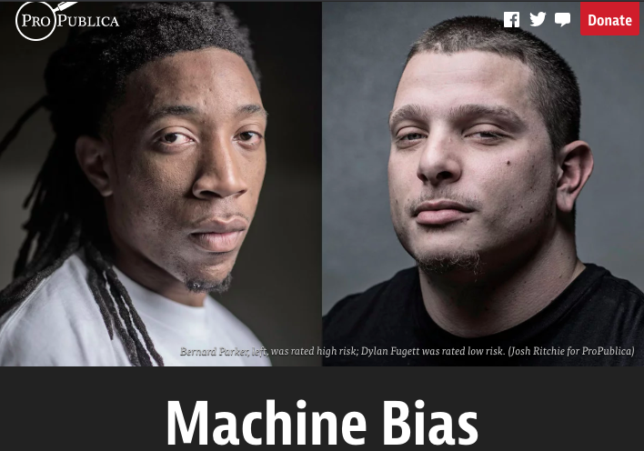
Incompatibility Between Fairness Metrics

Slide 24
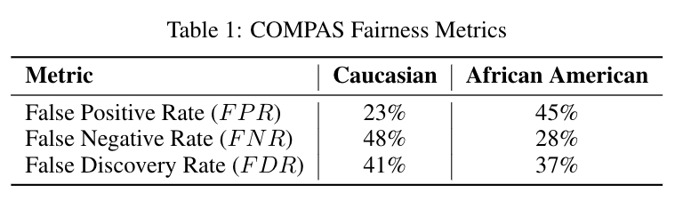
Incompatibility Between Fairness Metrics

Slide 25
Incompatibility Between Fairness Metrics
ProPublica identified considerable disparities:
The algorithm was twice as likely to incorrectly predict black individuals were at high risk of recidivating (FPR)
It was also nearly twice as likely to incorrectly predict white individuals were at low risk of recidivating (FNR)

Slide 26
Incompatibility Between Fairness Metrics
However, the creator of the algorithm pointed out that the algorithm is well-
balanced across races on precision (equivalently, FDR), claiming this is the
correct measure of fairness in this context.

Slide 27
Incompatibility Between Fairness Metrics
Who is right?
Is the COMPAS algorithm biased?
Can’t the algorithm achieve both measures of fairness at the same time?

Slide 28
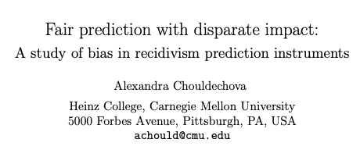
Incompatibility Between Fairness Metrics

Slide 29
Incompatibility Between Fairness Metrics

Slide 30
Incompatibility Between Fairness Metrics
False Positive Rate
Among all actual 0’s,
fraction predicted to be 1
False Negative Rate
Among all actual 1’s,
fraction predicted to be 0
Prevalence
Fraction of
actual 1’s in
population
False Discovery Rate
Among all predicted 1’s,
fraction that are actual 0’s
=(1 – precision)

Slide 31
Incompatibility Between Fairness Metrics
If prevalence is
unequal across
groups...

Slide 32
Incompatibility Between Fairness Metrics
If prevalence is
unequal across
groups...
…and FDR (or precision)
is equal across groups...

Slide 33
Incompatibility Between Fairness Metrics
If prevalence is
unequal across
groups...
…and FDR (or precision)
is equal across groups...
…then either FPR or FNR can be equal across groups, but not both

Slide 34
So… what does this mean?

Slide 35
So… what does this mean?
Sadly, no… we can’t have it all!
But this also doesn’t mean fairness is unachievable or we shouldn’t bother.
Instead, it means we have to carefully consider and choose the appropriate fairness metrics for our context

Slide 36
Some Motivating Case Studies
Lead Poisoning
Blight Violations
Student Tutoring

Slide 37
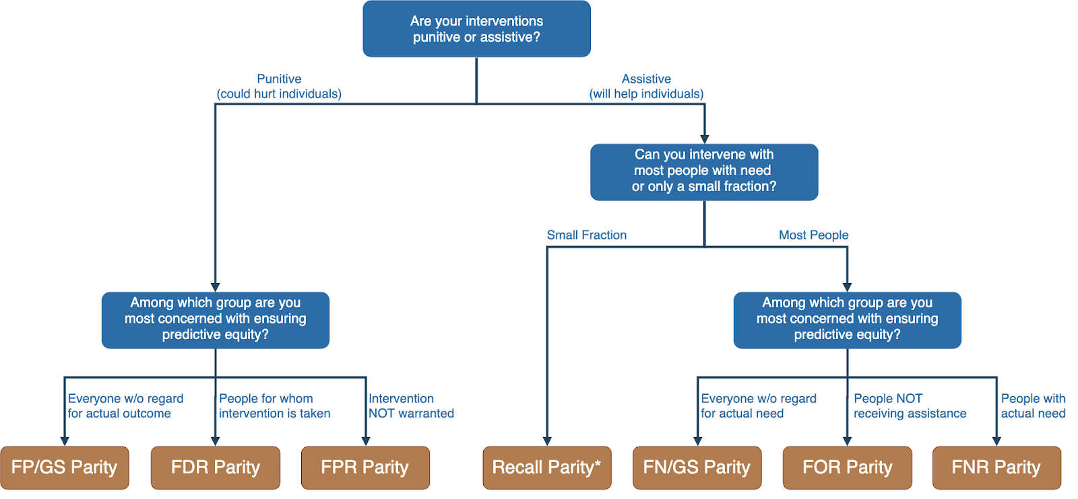
Translating policy goals to fairness metrics

Slide 38
Is the fairness tree “the answer”?

Slide 39
Is the fairness tree “the answer”?
No… but it’s intended as a starting point to help guide a conversation between ML experts, policy makers, and those affected by the decisions.
Ultimately, the choice of fairness metric(s) is highly dependent on context and stakeholder values.

Slide 40
Legal and Social Principles
Choices about fairness and equity are implicit in any decision process but being made explicit by the growing use of algorithmic decision support.

Slide 41
Legal and Social Principles
Choices about fairness and equity are implicit in any decision process but being made explicit by the growing use of algorithmic decision support. What implicit choices about fairness are encoded when we say…
Beyond a reasonable doubt? (e.g., criminal court)
The preponderance of evidence? (e.g., civil court)
Probable cause? (e.g., indictment by grand jury)
Innocent until proven guilty?

Slide 42
Legal Perspectives and Challenges
Title VII of US Civil Rights Act – Job Discrimination
Disparate Treatment (intentional discrimination)
Disparate Impact (regardless of intention)
14th Amendment
Equal Protection (under laws and government actions)
“Strict Scrutiny” Standard: compelling state interest, narrowly tailored, and least restrictive means
Notes:
14th Amendment often interpreted to prohibit racial classification in most cases (that is, taking race into account in state decision-making) as well as racial intentions/discriminatory purpose

Slide 43
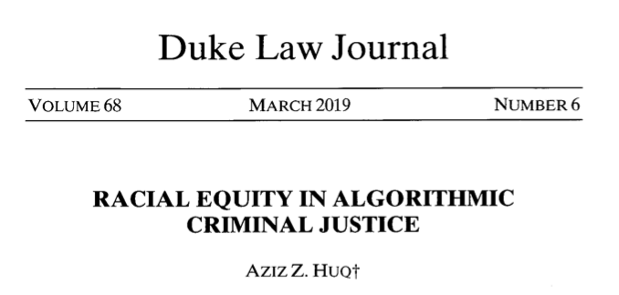
Legal Perspectives and Challenges

Slide 44
Legal Perspectives and Challenges
What Challenges Does Huq Identify Applying Current Legal Standards to Algorithmic Decision Making?

Slide 45
Legal Perspectives and Challenges
What Challenges Does Huq Identify Applying Current Legal Standards to Algorithmic Decision Making?
Expanded scale and reach of state power
Durability of errors – need for special skills to update/fix problems
What does “discriminatory intent” mean in this context?
Unclear how to apply “anticlassification” standard of equal protection

Slide 46
Legal Perspectives and Challenges
Difficulties with Equal Protection’s “Anticlassification” Standard:
Simply omitting race as a feature doesn’t ensure an algorithm is “colorblind” – too much correlated information in other features
Accounting for race may in fact be needed to decrease disparities

Slide 47
Legal Perspectives and Challenges
Drug Possession Rates
 | Black | White
Baseball Cap | 0% | 100%
No Cap | 2% | 2%

Slide 48
Legal Perspectives and Challenges
Drug Possession Rates
 | Black (25% of Pop.) | White (75% of Pop.)
Baseball Cap | 0% | 100%
No Cap | 2% | 2%
Race-Blind Policy:
75% Precision
Many Needless Searches of Minorities

Slide 49
Legal Perspectives and Challenges
Drug Possession Rates
 | Black (25% of Pop.) | White (75% of Pop.)
Baseball Cap | 0% | 100%
No Cap | 2% | 2%
Race-Aware Policy:
100% Precision
No Needless Searches of Minorities

Slide 50
Legal Perspectives and Challenges
How does Huq suggest modifying our criteria for assessing discrimination in this new context?

Slide 51
Legal Perspectives and Challenges
“Rather than asking about abstract definitions of fairness, a criminal justice algorithm should be evaluated in terms of its long-term, dynamic effects on racial stratification… [and] focus on the net burden thereby placed on the racial minority.”

Slide 52
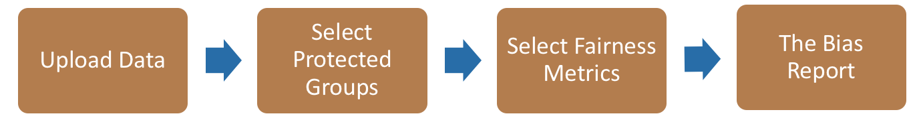

Bias Audit flow
Race
Sex
Age
Equal False
Omission Rate
Risk Score and Outcomes

Slide 53
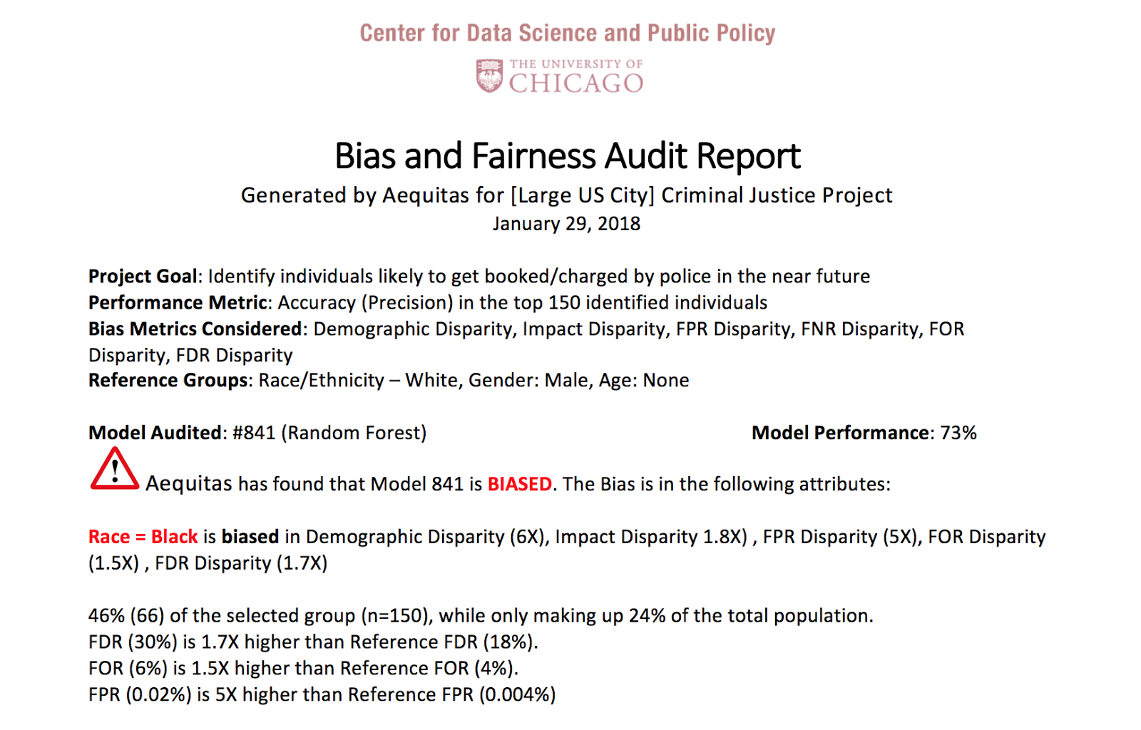
Aequitas: Bias Audit Tool
http://www.datasciencepublicpolicy.org/aequitas/ Joint Work with Pedro Saleiro

Slide 54
0%
Performance Metric
100%

Slide 55
100%
Bias
0%
Performance Metric
100%

Slide 56
Case Study: Policy Goals to Fairness Metrics to Model Selection
What is your policy goal?
Reduction in recidivism for all groups
Equal reduction in recidivism rates for all groups
Equal recidivism rate for all groups
Each goal requires optimizing and selecting models using a different fairness metric

Slide 57
Case Study: Prioritizing Early Diabetes Screenings in a fair and equitable way

Slide 58
Three Concepts of Fairness in ML
We’ve focused here on the concept of group fairness – balancing aggregate metrics across groups
Some also study the concept of individual fairness – that similar individuals should be treated similarly
An important related line of work concerns counterfactual fairness – how would your prediction if you were a member of a different group?

Slide 59
Practical Challenges with Individual Fairness
How do you measure “similarity”? Over what distance metric and what features?
Individual fairness doesn’t guarantee group fairness (but also vice-versa)
In the light of existing or historical discrimination, the protected attribute / group membership might be an important measure of dissimilarity in itself

Slide 60
Where does this leave us?
What can we do to understand bias and improve fairness of our systems?
Bias and equity audits
Try to fix the input data
Optimize for fairness in model training
Choose fair models during model selection
Post-hoc adjustments to de-bias model scores
Measure relative effectiveness of interventions across groups and develop better-tailored interventions

Slide 61
More on Bias and Fairness on Thursday…
Equity/Efficiency Trade-Offs
More on measuring bias
Mitigating disparities

Slide 62
Data and AI Ethics Issues
Privacy
Data Ownership
Bias, Equity, & Fairness
Transparency
Trustworthiness and Accountability

Slide 63
What do we need
Training (for analysts, managers, and policymakers)
Bias Audit Checklists and Processes
Tools (to help AI developers build equitable systems) that are embedded in to the workflow
“Insurance” Budget to test, monitor, and evaluate systems for equity
Regulations and Review Boards

Slide 64
Steps we’re taking
Training (lots of it)
Tools – for different stages of projects embedded in the ML and project workflow
Case Studies
Providing choices with clear policy implications
Focus on outcomes and actions – fair outcomes
Experiments
Research
Discovering biased populations subgroups when we don’t have predefined “protected” groups
Detecting causes/sources of Bias
Comparing different approaches to “correct” for the bias
Using bias as a primary metric to do model selection over time

Slide 65
Summary
Create an environment where informed ethical discussions can take place
Talk through ethical issues at each stage of the project (instead of waiting till the end of stopping after the initial setup)
Consider the entire chain of data - collection to analysis to action
Consider how it affects people throughout the chain – especially the people being affected (and include them in these discussions)
Embed ethics into both technical processes as well as people processes

Slide 66
Readings
Policy Paradox
Ethics and Data Science
Ethics and Policy in Data Science (Class at Cornell)
First, Do No Harm
FATML (workshops that have been happening for the past 4 years)

Slide 67
Useful Resources
Data Science Project Scoping Guide
Data Maturity Framework
Hitchhikers Guide to DSSG: Data Science Tutorials
Data Science Tools
Triage: data science pipeline (under development)
Aequitas: Bias Audit Tool (under development)
Explainer: Explaining individual predictions from ML models (upcoming)
Code for other projects: www.github.com/dssg

Slide 68
Reminders
Assignment for Tuesday:
Updates based on feedback
Readings for Thursday: Bias & Fairness Part II

